Slide 1
The process of Knowledge Discovery

Slide 2
Facing a real problem
In a hospital a particular the director call us to help him towards personalized medicine..
Personalized medicine, also termed precision medicine, is a medical procedure that separates patients into different groups—with medical decisions, practices, interventions and/or products being tailored to the individual patient based on their predicted response or risk of disease.
Stratified, personalised or P4 medicine: a new direction for placing the patient at the centre of healthcare and health education (Technical report). Academy of Medical Sciences. May 2015. Retrieved 6 Jan 2016.

Slide 3

How can data science help ?
Which patients?
Which treatments?
Which procedure?
Which disease?
Which…..
WHICH PROBLEM?

Slide 4
Ask an interesting question (I)
Most of the time we do not know what we are looking for.
Drugs side effects on groups of patients?
Groups of patients that respond better to a treatment?
What does better mean ?
What is a group of patients ? Similar according to which features

Slide 5
Ask an interesting question (II)
We can make many questions but
How the answer helps for an objetive?
Decrease mortality
Decrease leave days
Increase productivity
Improve patient satisfaction
…
We need to establish goals that map business objectives

Slide 6
Ask an interesting question (III) by Ryan Fox Squire
What tools do we need at these stage ?
your brain, talking to experts, experience
What are the skills of the Data Scientist that we require?
science, domain expertise, curiosity

Slide 7
Lets do it (I)
Is there any clinical or radiological pattern associated with the response to immune therapy?
Can we identify fast progressive patients and avoid unnecessary treatments?
Are there specific patterns in long surviving patients?
Are there any unknown epidemiological factors associated with tumors?
Does all the personal background of a patient influence in lung cancer?

Slide 8
Lets do it (II)
Can we identify populations candidate for lung cancer screening?
Can we identify patients who may be more prone to develop lung cancer?
Which diagnostic tests are more useful? Are the non useful diagnostic tests that we could avoid?
Are there drugs with a more toxic profile than others?
Is toxicity related to more factors other than drugs itself?

Slide 9
Mapping business questions into data science questions
Customers have real problems in their business
They are not data science related
We need to transform the interesting questions in data science interesting problems
We have to be able to plan how to solve it if feasible and which is the cost?
The solution is hidden in DATA!!!

Slide 10
We need data !!
What data do we have available?
EHR
Reports
Images
Results of lab
Are they integrated?
Ethics issues?
Standard
…

Slide 11
Get the data
How do we obtain the data?
Tools:
Mysql, Phyton, R, scripts,
Skills:
Data bases, data surfing, data cleaning, querying databases, lots of programming
DO NOT FORGET: we cannot use data if ethic committee is required!!

Slide 12
Explore the data
From all the data we have available:
Which ones are the basis to answer the questions?
Do we understand the variables?
Do we have outliers?
Do we have null values ?
Make a report
Check which data can be used to solve which problem

Slide 13
Example: Can we identify patients who may be more prone to develop lung cancer?
Databases:
Clinical note→ narrative
Contains all the information on the antecedents, treatments, diseases
Results of biopsy → excel file for each patient
Analyzes the mutations
Method:
Do we perform NLP ?
How do we integrate records ?

Slide 14
Explore data
Analyze all the sources
Check values, inconsistencies, derive new values
Treat null values
Generate tables for each possible problem to be solved
Skills:
Get to know data, develop hypotheses, patterns? anomalies?
Tools:
Statistics, visualization, databases. R, Python, matlab, …

Slide 15
Obtain models from the data
Each initial question has been translated to data mining problems
Here is where data mining tools and tecniques are applied
Skills
data mining techniques, machine learning, validation, big data
Tools:
R, Phyton, SPSSmodeler, Weka, Knime, ……

Slide 16
Evaluate and communicate
Results that are obtained have to be analyzed both from technical and from business view
Only when they respond to the initial queries we will communicate
Skills
presentation, speaking, visuals, writing
Tools
matplotlib, adobe illustrator, powerpoint/keynote

Slide 17
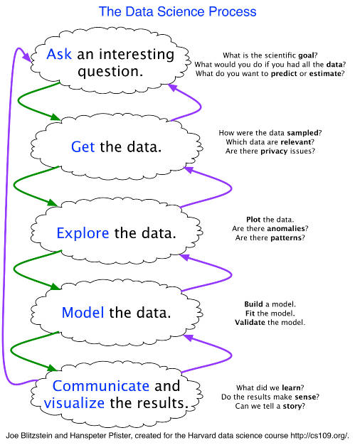

Slide 18
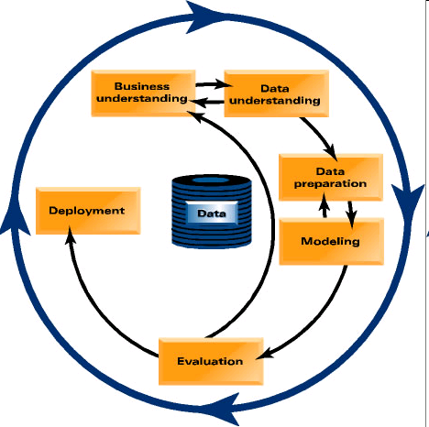
CRISP-DM: Overview

Slide 19
CRISP-DM: Phases
Business Understanding
Project objectives and requirements understanding, Data mining problem definition
Data Understanding
Initial data collection and familiarization, Data quality problems identification
Data Preparation
Table, record and attribute selection, Data transformation and cleaning
Modeling
Modeling techniques selection and application, Parameters calibration
Evaluation
Business objectives & issues achievement evaluation
Deployment
Result model deployment, Repeatable data mining process implementation

Slide 20
Phases and Tasks
Business
Understanding
Data
Understanding
Data
Preparation
Modeling
Evaluation
Deployment
Determine
Business
Objectives
Collect
Initial
Data
Select
Data
Select
Modeling
Technique
Evaluate
Results
Plan
Deployment
Assess
Situation
Describe
Data
Clean
Data
Generate
Test Design
Review
Process
Plan Monitering
&
Maintenance
Determine
Data Mining
Goals
Explore
Data
Construct
Data
Build
Model
Determine
Next Steps
Produce
Final
Report
Produce
Project Plan
Verify
Data
Quality
Integrate
Data
Assess
Model
Review
Project
Format
Data

Slide 21
Phase 1. Business Understanding
Statement of Business Objective
Statement of Data Mining Objective
Statement of Success Criteria
Focuses on understanding the project objectives and requirements from a business perspective, then converting this knowledge into a data mining problem definition and a preliminary plan designed to achieve the objectives

Slide 22
Phase 1. Business Understanding
Determine business objectives
- thoroughly understand, from a business perspective, what the client really wants to accomplish
- uncover important factors, at the beginning, that can influence the outcome of the project
- neglecting this step is to expend a great deal of effort producing the right answers to the wrong questions
Assess situation
- more detailed fact-finding about all of the resources, constraints, assumptions and other factors that should be considered
- flesh out the details

Slide 23
Can we identify patients who may be more prone to develop lung cancer?
thoroughly understand, from a business perspective, what the client really wants to accomplish:
How do we describe patients ?
Which information do we have of patients?
more detailed fact-finding about all of the resources, constraints, assumptions and other factors that should be considered:
Ethics– can data be used? In/out the hospital
Are records anonimized?
Are data integrated

Slide 24
Phase 1. Business Understanding
Determine data mining goals
- a business goal states objectives in business terminology
- a data mining goal states project objectives in technical terms
ex) the business goal: “Increase catalog sales to existing customers.”
a data mining goal: “Predict how many widgets a customer will buy, given their purchases over the past three years, demographic information (age, salary, city) and the price of the item.”
Produce project plan
- describe the intended plan for achieving the data mining goals and the business goals
- the plan should specify the anticipated set of steps to be performed during the rest of the project including an initial selection of tools and techniques

Slide 25
Phase 1. Business Understanding
Can we identify patients who may be more prone to develop lung cancer?
Determine data mining goals
given the information on a patient (age, gender, smoke and clinical variables). predict which is the probability to develop lung cancer
Produce project plan
Objective, Workpackages, milestones, deliverable, cost, risks, gantt chart, ….
Goal | Attributes | Indicator of success | Dataset | Business goal it helps to achieve (%)

Slide 26
Project plan
Scope
Business goal
Data Mining goals
Workpackages
Gantt Chart
Budget
Risk plan

Slide 27
Phase 2. Data Understanding
Explore the Data
Verify the Quality
Find Outliers
Starts with an initial data collection and proceeds with activities in order to get familiar with the data, to identify data quality problems, to discover first insights into the data or to detect interesting subsets to form hypotheses for hidden information.

Slide 28
Phase 2. Data Understanding
Collect initial data
- acquire within the project the data listed in the project resources
- includes data loading if necessary for data understanding
- possibly leads to initial data preparation steps
- if acquiring multiple data sources, integration is an additional issue, either here or in the later data preparation phase
Describe data
- examine the “gross” or “surface” properties of the acquired data
- report on the results

Slide 29
Phase 2. Data Understanding
Collect initial data
List all the datasources
Describe data
How do we describe data ?
In natural language ?
Describe every file
For each file/table:
Describe every variable: type, possible values, max, min, avrg, .. Distribution, how it is obtained, meaning,
Describe for each variable it later usage: has to be normalized, preprocessed, or can it be used as it is ?

Slide 30
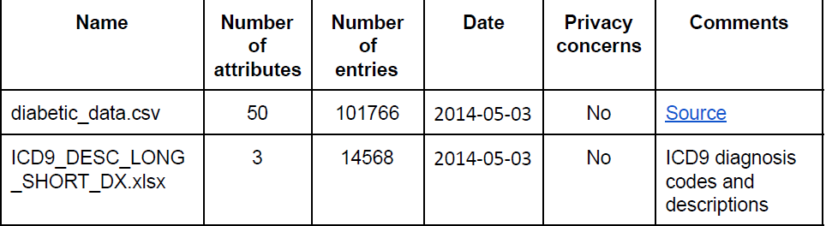
Collect and describe data example

Slide 31
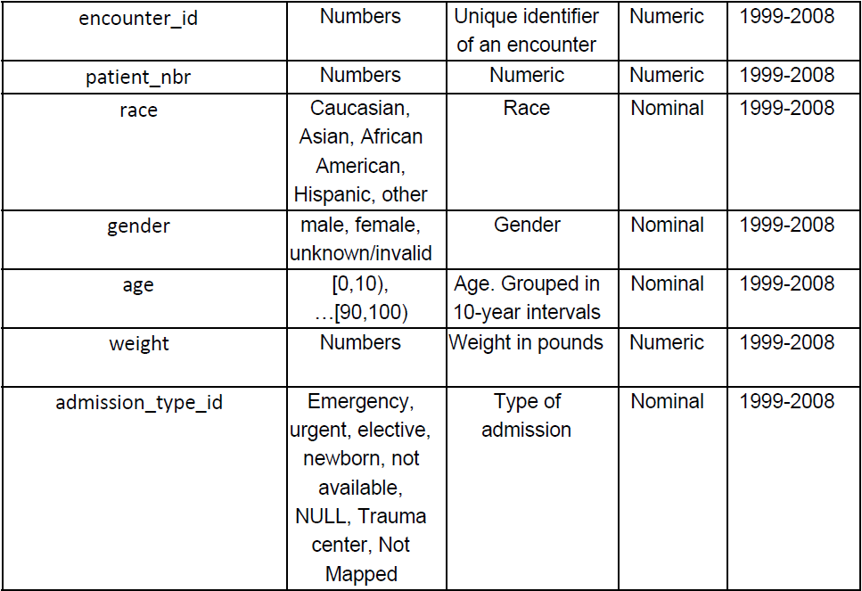
Collect and describe data example

Slide 32
Phase 2. Data Understanding
Explore data
- tackles the data mining questions, which can be addressed using querying, visualization and reporting including:
distribution of key attributes, results of simple aggregations
relations between pairs or small numbers of attributes
properties of significant sub-populations, simple statistical analyses
- may address directly the data mining goals
- may contribute to or refine the data description and quality reports
- may feed into the transformation and other data preparation needed
Verify data quality
- examine the quality of the data, addressing questions such as:
“Is the data complete?”, Are there missing values in the data?”

Slide 33
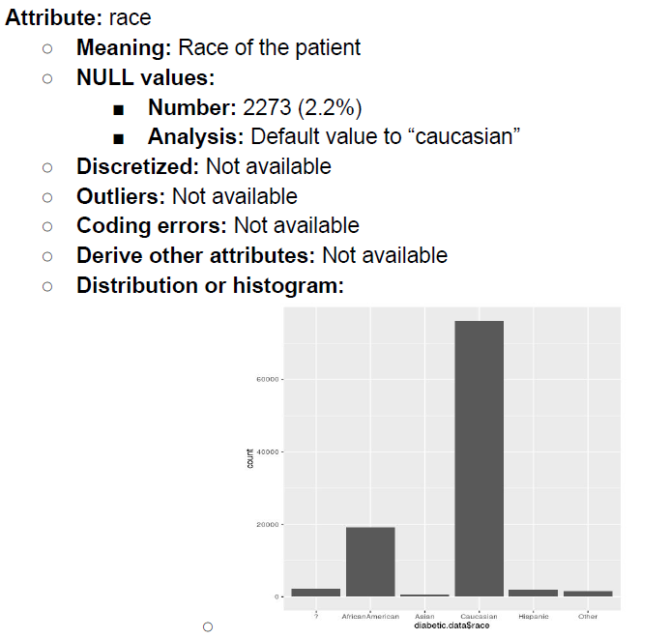
Explore data

Slide 34
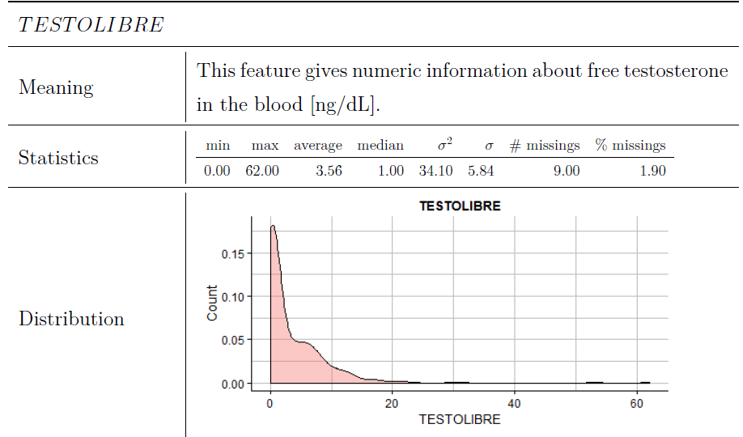
Explore data

Slide 35
Phase 3. Data Preparation
Takes usually over 90% of the time
- Collection
- Assessment
- Consolidation and Cleaning
- Data selection
- Transformations
Covers all activities to construct the final dataset from the initial raw data. Data preparation tasks are likely to be performed multiple times and not in any prescribed order. Tasks include table, record and attribute selection as well as transformation and cleaning of data for modeling tools.

Slide 36
Phase 3. Data Preparation
Select data
- decide on the data to be used for analysis
- criteria include relevance to the data mining goals, quality and technical constraints such as limits on data volume or data types
- covers selection of attributes as well as selection of records in a table
Clean data
- raise the data quality to the level required by the selected analysis techniques
- may involve selection of clean subsets of the data, the insertion of suitable defaults or more ambitious techniques such as the estimation of missing data by modeling

Slide 37
Phase 3. Data Preparation
Select data
Decide on the variables to be used
Pay special attention to:
Irrelevant features
Null values:
NA
99999
A1: do you smoke
A2: how many cigarrettes ? (in the case of A1=No A2 will be null..)
Outliers

Slide 38
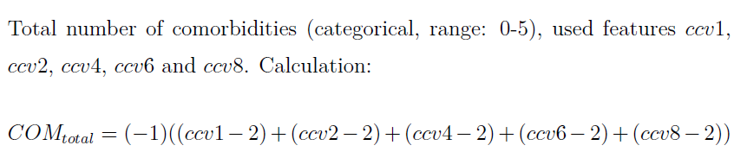
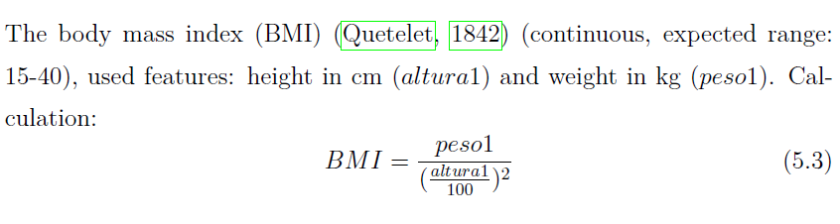
Phase 3. Data Preparation
Construct data
- constructive data preparation operations such as the production of derived attributes, entire new records or transformed values for existing attributes

Slide 39

Phase 3. Data Preparation
Integrate data
- methods whereby information is combined from multiple tables or records to create new records or values

Slide 40
Phase 3. Data Preparation
Format data
- formatting transformations refer to primarily syntactic modifications made to the data that do not change its meaning, but might be required by the modeling tool:
Null Imputation
Discretization
From categorical to numerical

Slide 41
Data preparation
Role of persons
How do you describe each step?
Standard: has to be understand
It is required that each transformation to data is reported
Data analysis after preparation
Describe each atribute and table after preparation.
Analyze new distribution of values

Slide 42
Phase 4. Modeling
Select the modeling technique
(based upon the data mining objective)
Build model
(Parameter settings)
Assess model (rank the models)
Various modeling techniques are selected and applied and their parameters are calibrated to optimal values. Some techniques have specific requirements on the form of data. Therefore, stepping back to the data preparation phase is often necessary.

Slide 43
Phase 4. Modeling
Select modeling technique
- select the actual modeling technique that is to be used
ex) decision tree, neural network
- if multiple techniques are applied, perform this task for each techniques separately
Generate test design
- before actually building a model, generate a procedure or mechanism to test the model’s quality and validity
ex) In classification, it is common to use error rates as quality measures for data mining models. Therefore, typically separate the dataset into train and test set, build the model on the train set and estimate its quality on the separate test set

Slide 44
Phase 4. Modeling
Build model
- run the modeling tool on the prepared dataset to create one or more models
Assess model
- interprets the models according to his domain knowledge, the data mining success criteria and the desired test design
- judges the success of the application of modeling and discovery techniques more technically
- contacts business analysts and domain experts later in order to discuss the data mining results in the business context
- only consider models whereas the evaluation phase also takes into account all other results that were produced in the course of the project

Slide 45
Phase 5. Evaluation
Evaluation of model
- how well it performed on test data
Methods and criteria
- depend on model type
Interpretation of model
- important or not, easy or hard depends on algorithm
Thoroughly evaluate the model and review the steps executed to construct the model to be certain it properly achieves the business objectives. A key objective is to determine if there is some important business issue that has not been sufficiently considered. At the end of this phase, a decision on the use of the data mining results should be reached

Slide 46
Phase 5. Evaluation
Evaluate results
- assesses the degree to which the model meets the business objectives
- seeks to determine if there is some business reason why this model is deficient
- test the model(s) on test applications in the real application if time and budget constraints permit
- also assesses other data mining results generated
- unveil additional challenges, information or hints for future directions

Slide 47
Phase 5. Evaluation
Review process
- do a more thorough review of the data mining engagement in order to determine if there is any important factor or task that has somehow been overlooked
- review the quality assurance issues
ex) “Did we correctly build the model?”
Determine next steps
- decides how to proceed at this stage
- decides whether to finish the project and move on to deployment if appropriate or whether to initiate further iterations or set up new data mining projects
- include analyses of remaining resources and budget that influences the decisions

Slide 48
Phase 6. Deployment
Determine how the results need to be utilized
Who needs to use them?
How often do they need to be used
Deploy Data Mining results by
Scoring a database, utilizing results as business rules,
interactive scoring on-line
The knowledge gained will need to be organized and presented in a way that the customer can use it. However, depending on the requirements, the deployment phase can be as simple as generating a report or as complex as implementing a repeatable data mining process across the enterprise.

Slide 49
Phase 6. Deployment
Plan deployment
- in order to deploy the data mining result(s) into the business, takes the evaluation results and concludes a strategy for deployment
- document the procedure for later deployment
Plan monitoring and maintenance
- important if the data mining results become part of the day-to-day business and it environment
- helps to avoid unnecessarily long periods of incorrect usage of data mining results
- needs a detailed on monitoring process
- takes into account the specific type of deployment

Slide 50
Phase 6. Deployment
Produce final report
- the project leader and his team write up a final report
- may be only a summary of the project and its experiences
- may be a final and comprehensive presentation of the data mining result(s)
Review project
- assess what went right and what went wrong, what was done well and what needs to be improved

Slide 51
Summary
Why CRISP-DM?
The data mining process must be reliable and repeatable by people with little data mining skills
CRISP-DM provides a uniform framework for
- guidelines
- experience documentation
CRISP-DM is flexible to account for differences
- Different business/agency problems
- Different data

Slide 52
Hands on it
Now that people live longer, older adults need to live better and independently (i.e. without disability). Avoiding disability in older adults has a potential impact on over 13 million of EU citizens and an economic impact of 1,500 million euros per year.
The prevention of disability has become the most challenging concern for current Health Care providers. Disability cannot be reversed, but it is preceded, sometimes by several years, by a known frailty syndrome, which can be reversed, and thus prevented from worsening and its progression monitored.
Frailty is characterized by a decreasing capacity to respond to demands, caused by diminishing functional reserve. The prevalence of frailty in people 65+ ranges from 7% to 16.3%, increasing with age, and it is the main risk factor for disability.
Frailty assessment is a key tool for the prevention of disability: Identify people at risk.

Slide 53
Information for solving the problem an knowing the datasets to be used:
https://www.ncbi.nlm.nih.gov/pubmed/27886869
https://www.ncbi.nlm.nih.gov/pubmed/22159772
http://www.sciencedirect.com/science/article/pii/S1525861017302232?via%3Dihub

Slide 54
How do we translate this problem into a data science problem?
In groups make a proposal (5 pages max)

